Slide 1
Content Audits 102
IMAGE
How to Perform a Content Audit
Anna Hall, UX Content Strategist
July 31, 2024
Notes:
No image title slide - Any text that looks black is HEX code 414042.

Slide 2
An Introduction
What to expect in this seminar
Notes:
This slide is used as a transition title slide for a new section

Slide 3
Agenda
Introduction to Content Audits (Re-cap) What is a Content Audit Types of Content Audits Planning Your Audit Where to Start What to Include Audit in Action Completing the Audit Analyzing Your Results
vita.virginia.gov
Notes:
This slide background works best with text heavy sections, with no imagery OR when an Icon is used

Slide 4
Introduction to Content Audits
Let's get started...
Notes:
This slide is used as a transition title slide for a new section

Slide 5
Introduction to Content Audits

Slide 6
Introduction to Content Audits

Slide 7
Introduction to Content Audits
What is a Content Audit? The process of reviewing and evaluating all existing content on your website. Catalogs your website content in a single database or spreadsheet. Definition: Evaluating the substance of your website for appropriateness, effectiveness, and efficiency. Why it Matters It helps you identify problem areas such as low-visibility pages, underperforming content, and old or outdated content It helps to ensure your content is relevant, useful, and purposeful to your audience It provides data-driven insights which help you make informed decisions based on factual information rather than assumptions

Slide 8
Types of Content Audits
Quantitative Audit Quantitative content audits focus on objective measurements of your website content. This type of audit starts with an inventory of your website’s pages – essentially a list of everything you have and where it lives. Qualitative Audit – Best Practices Assessment This type of audit is typically conducted by a third party and evaluates how your content compares to industry best practices. Qualitative Audit – Strategic Assessment This audit takes stock of all your content and how each piece measures up to strategic business goals. A qualitative content audit primarily focuses on: Content quality Content structure Audience alignment Tone of voice User experience

Slide 9
Different Approaches to Content Audits
Full Audit A full content audit is a complete and comprehensive accounting of a website’s content. In other words, audit absolutely everything. This may include all pages as well as all assets. Partial Audit A partial audit focuses on a specific section or pages on a website. Rolling Audit This type of audit may be defined as a perpetual scan of a website’s content that occurs at certain time intervals (quarterly, monthly, yearly). Basically, it’s a continual process.

Slide 10
When is it Time for a Content Audit?
When Should You Perform a Content Audit? Prepping for a website redesign CMS upgrade Change in messaging/website refresh It’s been a while You’ve never done an audit Rolling basis – yearly or quarterly depending on your content

Slide 11
Planning Your Audit
Notes:
This slide is used as a transition title slide for a new section

Slide 12
Planning Your Audit
First Steps: Set Goals Identify Timelines Identify Stakeholders Who needs to be involved, informed, accountable

Slide 13
Which Audit is Right for Me?
Determine Which Audit is Best for Your Goals: What do you want to learn (and why)? What do you need to prove (and to whom)? How long do you have to get this done? What’s the purpose of your audit? What are your anticipated next steps?

Slide 14
Where to Start
Prepare Your Content Inventory A content inventory is a crucial first step in understanding the scope and breadth of your content. Create a Content Hierarchy Organize webpages in a tiered system, either by category or existing sitemap structure. Create a List of Content Owners This will come in handy when it’s time to assign content ownership for content review. Choose Your Scope and Criteria This is an important for planning your audit and identifying what, when, and how to conduct your audit.
Notes:
The 7 Principles of Universal Design were developed in 1997 by a working group of architects, product designers, engineers and environmental design researchers, led by the late Ronald Mace in the North Carolina State University (NCSU). The purpose of the Principles is to guide the design of environments, products and communications. According to the Center for Universal Design in NCSU, the Principles "may be applied to evaluate existing designs, guide the design process and educate both designers and consumers about the characteristics of more usable products and environments."

Slide 15
Content Inventory
What is a Content Inventory? A content inventory allows you to see all the content you currently have on your website. It is a crucial step in the content audit process. Why is it important? Useful in the initial project planning phase It can help to inform site structure It can serve as a way to audit/analyze your content Key Steps: Create a template (spreadsheet) Use a sitecrawling tool to generate a full list of pages on your site (Siteimprove, Screaming Frog) Copy relevant data into your content inventory template Organize and refine your template

Slide 16
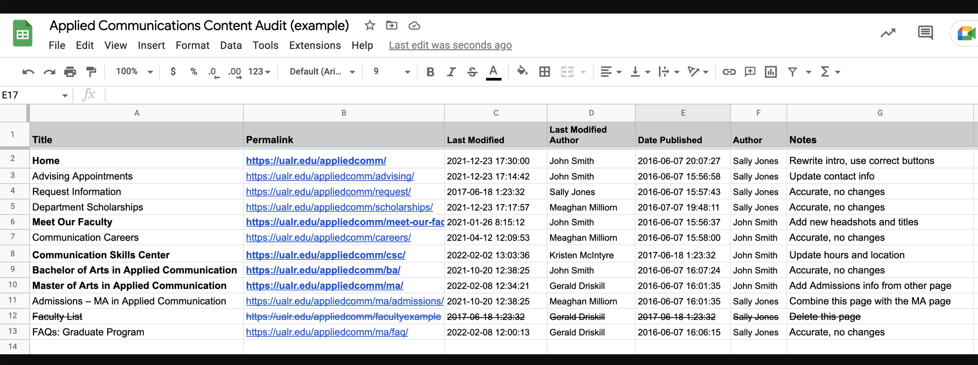
Content Inventory
Sample Content Inventory
Source: University of Little Rock

Slide 17
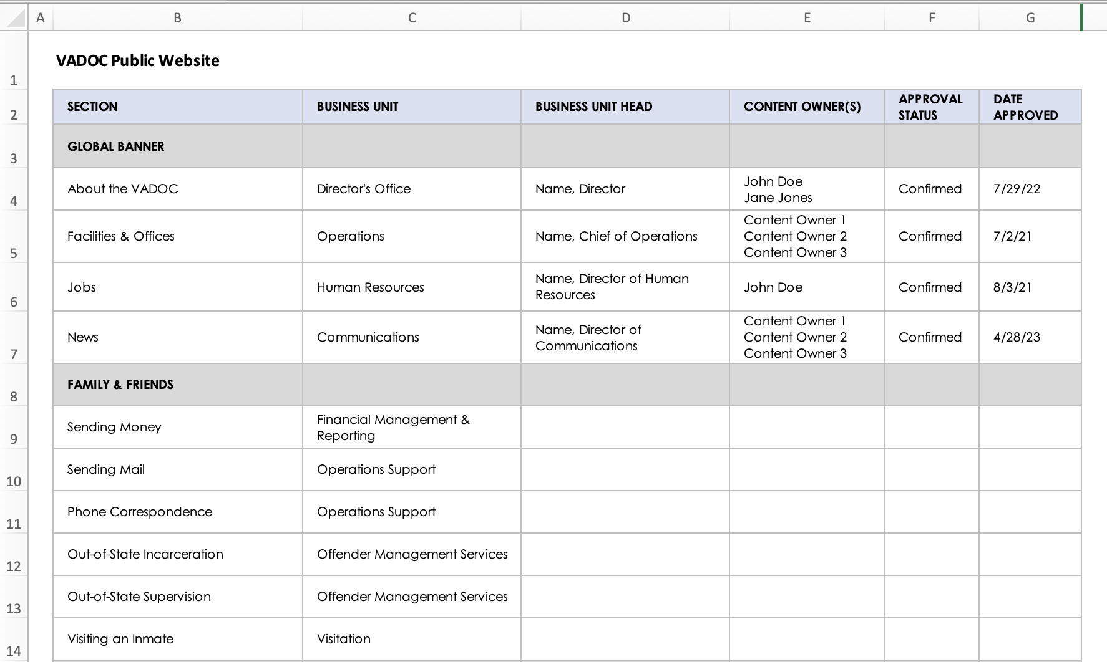
Content Inventory
Sample Content Inventory

Slide 18
Content Hierarchy
What is Content Hierarchy? Content hierarchy refers to the basic relationship between content items This relationship is visually represented in the content inventory: Each row of the spreadsheet represents a single web page Child pages are listed in rows below the parent page (and one column to the right) Why is it Useful? The hierarchical representation makes it easy to see how your content is structured It allows you to better organize your content inventory, eliminating pages that may not need to be included in the audit (e.g., PDFs, news articles, policies, etc.)

Slide 19
Establish Content Ownership
Create a List of Content Owners Each webpage (or section) should have an assigned content owner This should be completed before conducting a full content audit Start by engaging stakeholders, discussing roles and responsibilities Why is it Useful? It allows you to establish or reaffirm the content governance process It fosters communication with business owners and content owners, and allows you to clearly define content owner roles and responsibilities Identifies potential gaps (vacant or unknown content owners) Helpful Tip: Make sure that content owners have been confirmed by the business owner/decision maker It is a good idea to also include both primary and secondary content owners in your list Communicate important details about the audit including start dates and deadlines

Slide 20
Choosing the Scope and Criteria
You’ll want to choose a scope for your content inventory and audit that fits your agency’s needs and your team’s capacity. You may choose to audit the entire website or a just a subsection. Consider the following recommendations: Spreadsheets tend to work best for content inventories and audits. For large or complex content sections (e.g., course catalog, program listing, facility directories), consider modifying the audit schedule to keep your project on track. Decide how to prioritize your content when setting your audit schedule (ex., most important, low-hanging fruit). Set realistic goals and timeframes for completing the audit

Slide 21
Audit in Action
Notes:
This slide is used as a transition title slide for a new section

Slide 22
Audit in Action
What to Include in Your Audit Template? Navigation title (or section) Page name URL Content hierarchy Content owner/business owner/business unit Creation date or date last updated Notes section Audit status (i.e., action taken)

Slide 23
Audit in Action
Completing Your Spreadsheet Now that you’ve completed your content inventory template, it’s time to fill in the details! Update content owners and business owners for each page and section (use the information form the content owner list) You may need to dig into your content management system to find dates as well as your analytics platform to see performance date (depending on your audit criteria) Choosing Your Evaluation Criteria The set of evaluation criteria for the auditing process is usually twofold. It includes, but isn’t limited to: Industry best practices (e.g., plain language, accessibility, readability) Your agency’s specific set of content standards, user needs, and goals (e.g., accuracy, relevancy, timeliness)

Slide 24
Audit in Action
Evaluating Your Content Content audits are action-driven to help you make content-related decisions such as: Keep: Don’t touch it! Update: Can we make it better? If so, how? Remove: Can you dump it? Other terminology, same concept: Keep – Kill – Clean-up ROT (redundant, outdated, trivial)

Slide 25
Scenario #1 – Rolling Audit
Assumptions: Your agency has recently gone through a website redesign, and your content was overhauled in the process. Now you need to start auditing your content to maintain the health of your website. The Process: Prepare a content inventory Set up an audit template (spreadsheet) Assign content owners for each webpage Determine audit frequency for each section of content Note: some content may be reviewed more frequently; some content may require a longer lead time to review and update. Create actionable tasks for content review Communicate with stakeholders and content owners about audit expectations and timelines

Slide 26
Scenario #2 – Full Audit
Assumptions: You are in the early stages of a website redesign project, and you need to account for all content on the current website. The Process: Prepare a content inventory Set up an audit template (spreadsheet) Add quantitative and qualitative metrics to your audit template Analytics data – pageviews, navigation depth, time spent on page, ranking Qualitative data – clarity, readability, appropriateness/usefulness, tone Assign content owners for each webpage Create actionable tasks for content review

Slide 27
Analyzing Your Results
Leverage Analytics to Maintain the Content Audit Use Siteimprove and Google Analytics to analyze how your content is performing: Quality assurance Accessibility Page traffic Time on spent page Pages per session Making Your Content Audit Last Once you have completed the content audit process, you should have clearer path to refining your content and website structure. Conduct on-going content audits to ensure your content is being reviewed on a regular basis. Conduct audits no less than once per year. Frequently updated content should be audited quarterly or semi-annually.

Slide 28
Questions?

